Slide 1
Ant Colony Optimization
Winter 2009
Application of Computational Intelligence in Engineering

Slide 2
Introduction
In early 1990s, ant colony optimization (ACO) was introduced by M. Dorigo as a nature-inspired metaheuristic for solving hard combinatorial optimization (CO) problems.
ACO belongs to metaheuristics which are approximate algorithms used to obtain good enough solutions in reasonable computation time.
The inspiring source of ACO is the foraging behavior of real ants.
Searching for food, ants initially explore the area near nest in a random manner. As soon as one finds a food source, it evaluates the quantity/quality of food and carries some back to the nest. During the return trip, ant deposits a chemical pheromone trail on the ground. The quantity of pheromone deposited, which may depend on the quantity/quality of food, will guide other ants to the food source.
As shown, indirect communication between the ants via pheromone trails enables them to find shortest paths between nest and food. This characteristic of real ant colonies is exploited in artificial ant colonies in order to solve CO problems.

Slide 3
References
M. Dorigo,V. Maniezzo, A. Colorni, Positive feedback as a search strategy,Tech. Report 91-016, Dipartimento di Elettronica, Politecnico di Milano, Italy, 1991.
M. Dorigo, Optimization, learning and natural algorithms (in Italian), Ph.D. Thesis, Dipartimento di Elettronica, Politecnico di Milano, Italy, 1992.
M. Dorigo, V. Maniezzo, A. Colorni, Ant system: optimization by a colony of cooperating agents, IEEE Trans. Systems, Man, Cybernet.-Part B 26 (1) (1996) 29–41.
M. Dorigo, L.M. Gambardella, Ant colony system: a cooperative learning approach to the traveling salesman problem, IEEE Trans. Evol. Comput. 1 (1) (1997) 53–66.
M. Dorigo, T. Stutzle, Ant Colony Optimization, MIT Press, Cambridge, MA, 2004.
    http://iridia.ulb.ac.be/~mdorigo/ACO/

Slide 4

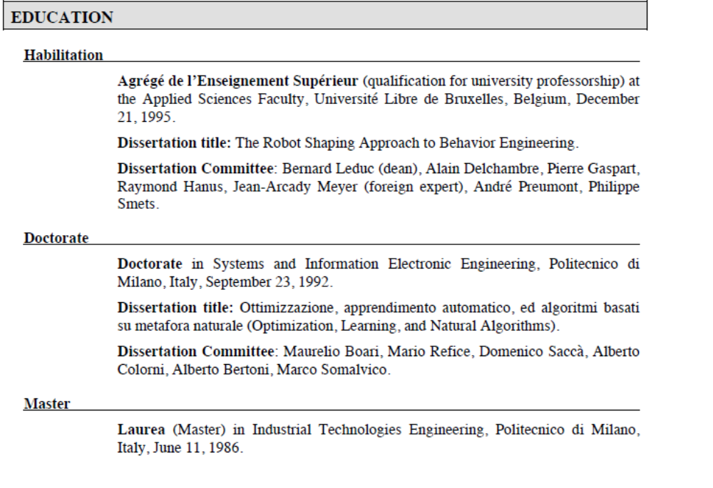

Slide 5
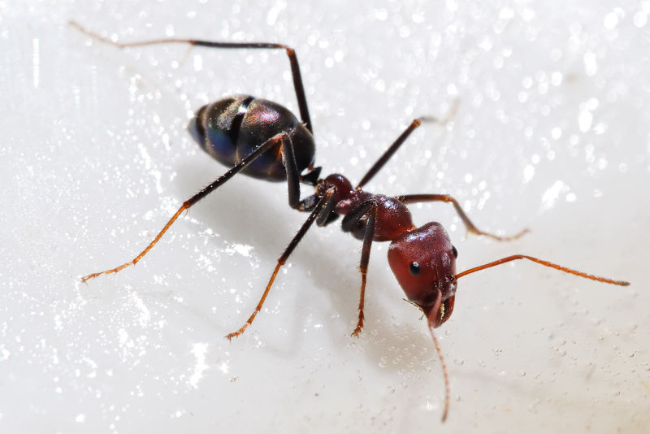
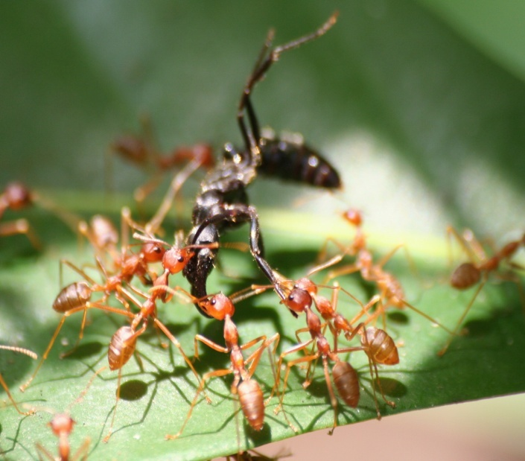
Motivation
Inspired by the behavior of ants in finding paths from the colony to food
Known for their highly organized colonies, which may consist of millions of individuals.
Colony works as a unified entity
Application of Computational Intelligence in Engineering

Slide 6
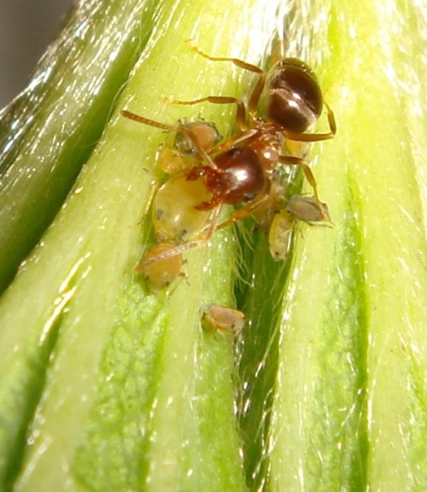
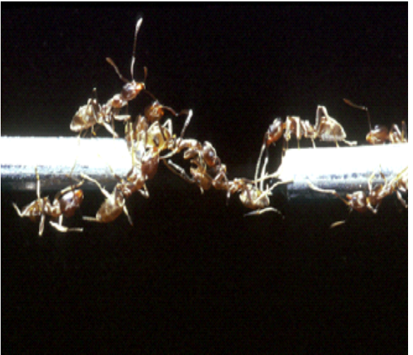
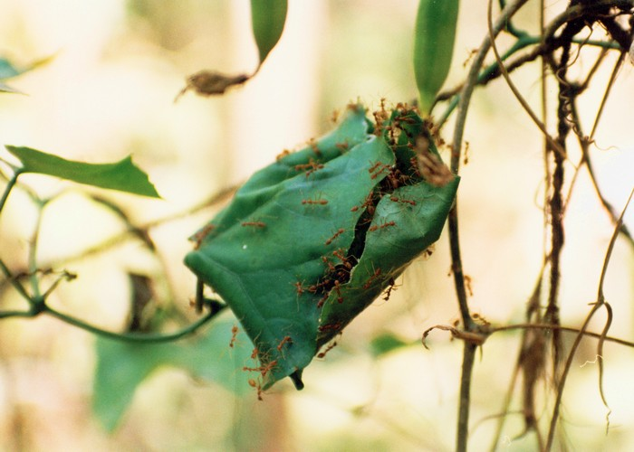
Better Together
Individually, ants are blind and may be stupid, but put enough of them together and they manage cooperatively (decentralized and self-organized) to build nests, grow fungus as food, milk aphids, and weave their own shelters
Application of Computational Intelligence in Engineering

Slide 7
Pheromone-driven Search
When ants forage, they randomly wander the forest or jungle floor and lay a trail for nest-mates to lead them to a source of food.
Many individual ants may discover different routes to the same food but the shortest path that leads to it will have the strongest concentration of pheromone, a chemical indicator laid down by the ants.
Application of Computational Intelligence in Engineering

Slide 8
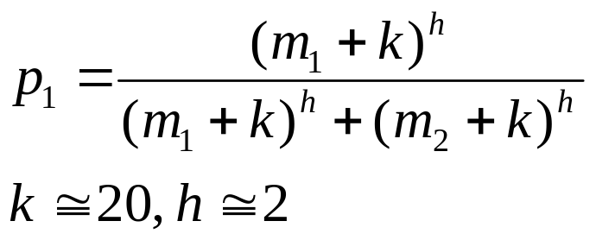
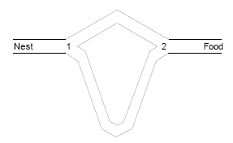
Binary Bridge Experiment from J.-L. Deneubourg et al. “The Self-organizing Exploratory Pattern of Argentine Ant” in Journal of Insect Behavior, Vol. 3, 1990, pp. 159-168
After t time units, m₁ ants had used the first bridge and m₂ the second one, the probability p₁ for the (m₁+m₂+1)th ant to choose the first bridge can be given by
Application of Computational Intelligence in Engineering

Slide 9
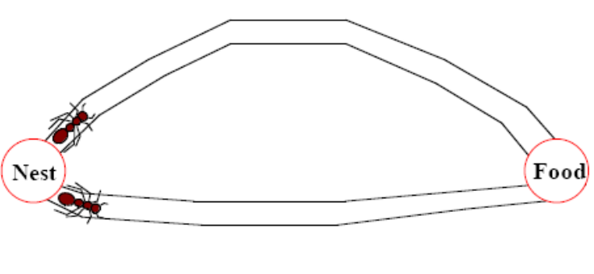
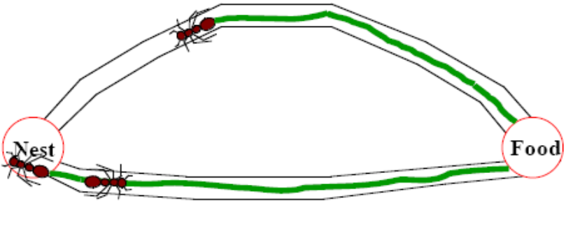
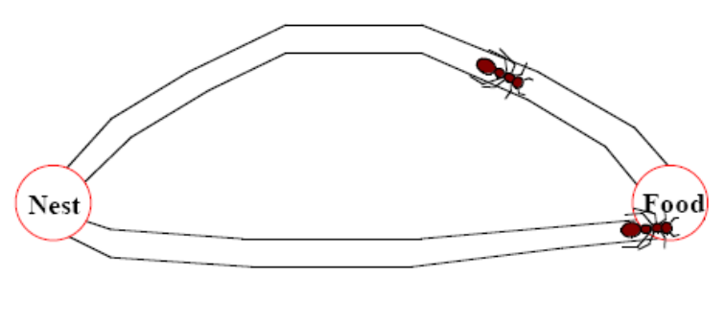
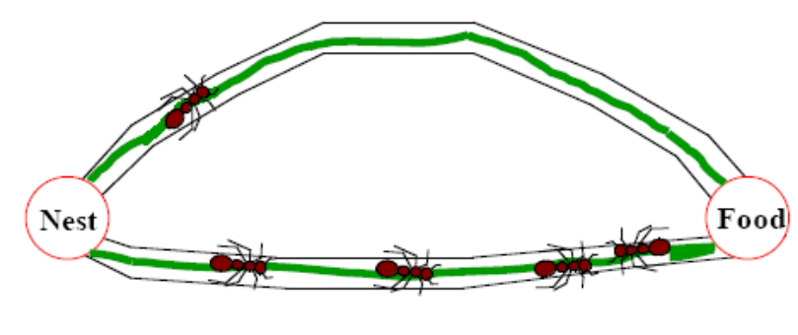
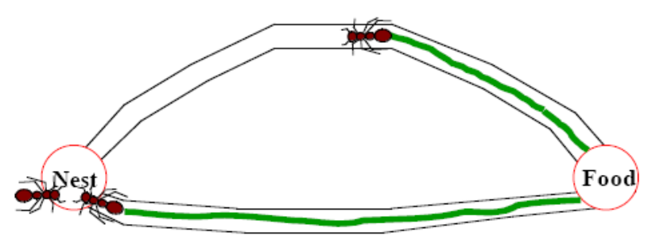
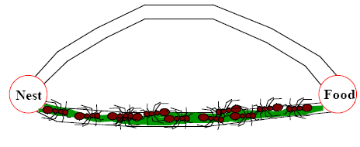
Search for the Shortest
(A)
(D)
(E)
(B)
(C)
(F)
Application of Computational Intelligence in Engineering
by Harshal Patil

Slide 10
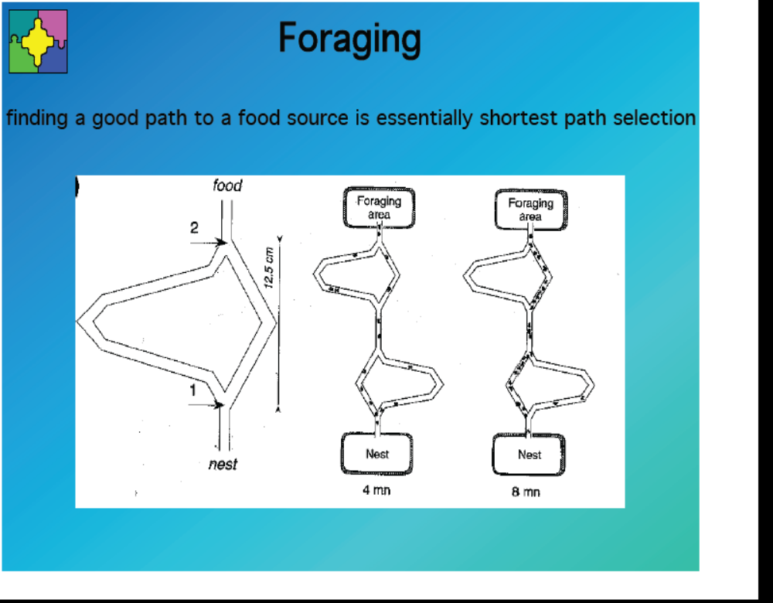

Slide 11
Applications of Ant Colony
Primarily combinatorial optimization problems (with discrete and finite solution spaces)
  TSP
  Assignment and Facility layout
  Scheduling of limited resources
  Stock cutting
  Transportation and vehicle routing (deliver goods from central depots to customers)
  Construction Engineering: design of steel frames and water distribution systems
Application of Computational Intelligence in Engineering

Slide 12
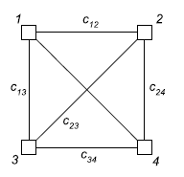
Graphical Representation
A number of artificial ants are simulated to move on a graph that encodes as right with vertices (nodes) and edges (links)
The goal is to find the shortest path
A variable called pheromone is associated with each edge and can be read and modified by ants.
Application of Computational Intelligence in Engineering

Slide 13
Idea (1)
At each iteration, each of the ants builds a solution by walking from vertex to vertex on the graph with the constraint of not visiting any vertex previously visited
At each step of solution construction, an ant selects the next vertex according to a stochastic mechanism that is biased by the pheromone: an unvisited vertex j can be selected with a probability that is proportional to the pheromone associated with edge (i, j).
Application of Computational Intelligence in Engineering

Slide 14
Idea (2)
At the end of an iteration, on the basis of the quality of the solutions constructed by the ants, the pheromone values are modified (increase intensity while evaporating) in order to bias ants in future iterations to construct solutions similar to the best ones previously constructed
Pheromone evaporation is to avoid the convergence to a locally optimal solution
Application of Computational Intelligence in Engineering

Slide 15
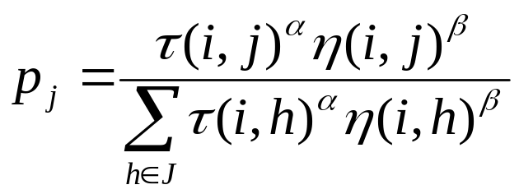
Sketch (1)
Initial population
  Create a population of ants; distribute them across the vertices when the start vertex is unknown
Ant movement
  Use state transition probability (will come back to this later) to determine next
  unvisited vertex to reach
Application of Computational Intelligence in Engineering

Slide 16
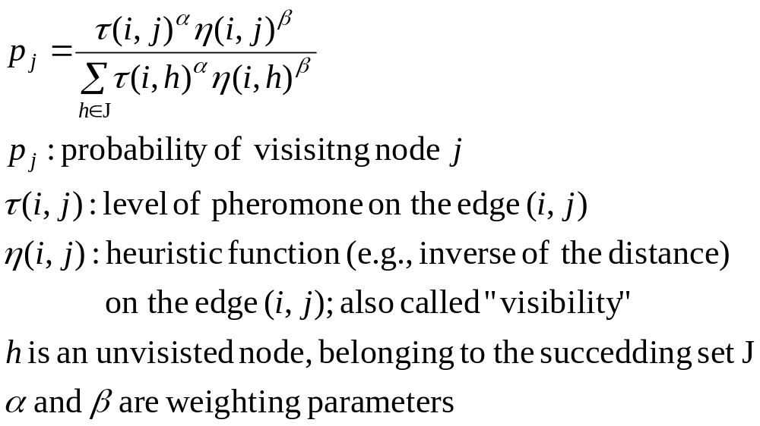
Sketch (2)
Application of Computational Intelligence in Engineering

Slide 17
Sketch (3)
Ant tour
  An ant completes its tour when it visits all the vertices (no cycle is permitted; thus need to maintain a list of unvisited vertices)
  Evaluate the length of the entire tour based on a list of vertices in the current tour
Application of Computational Intelligence in Engineering

Slide 18
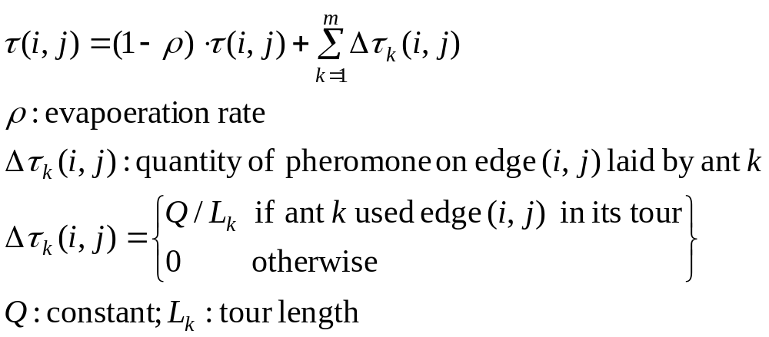
Sketch (4)
Pheromone intensification and evaporation
Application of Computational Intelligence in Engineering

Slide 19
Sketch (5)
Start next iteration, pass on pheromone information
Clear memory of ants (create a new list of unvisited vertices)
Place ants on vertices
Ants work on new tours according to the updated pheromone and the visibility
Application of Computational Intelligence in Engineering

Slide 20
Sample Iteration (1)
At iteration t, two ants Z1 and Z2 started at vertex V; each takes a different path: X1 and X2
The pheromone level on X1 and X2 is currently 0.4 and 0.6
After reaching the end, Z1 traveled 20 steps whereas Z2 traveled 10 steps
Other parameters are
  Q = 10; α =1; β =2; ρ =0.6
X1
V
X2
Application of Computational Intelligence in Engineering

Slide 21
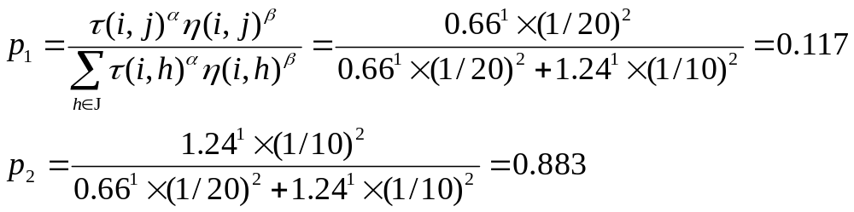
Sample Iteration (2)
After this iteration, pheromone becomes
For X1, τ₁ = (1-0.6)×0.4 + 10/20 = 0.66
For X2, τ₂ = (1-0.6)×0.6 + 10/10 = 1.24
Restart ants at vertex V
Ants would pick X2 with higher probability
Application of Computational Intelligence in Engineering

Slide 22
Suggested Parameters
Weighting parameters
  Usually β ≧ α; visibility is a greater determinant than pheromone
Evaporation rate
  Avoid locally optimal solutions
  Usually ρ ≧ 0.4
Number of ants
  Problem specific; may increase as progress
Application of Computational Intelligence in Engineering

Slide 23
TSP Review
Find, for a given set of n cities with distance dij between each pairs of cities, a shortest tour that contains every city exactly once
Distance dij is recorded in a square matrix (symmetrical or unsymmetrical); the diagonal elements are set to be large to prohibit cycling
Application of Computational Intelligence in Engineering

Slide 24
ACO applied to TSP
Pheromone information is stored in a square matrix; each element denotes the quantity of pheromone on an edge (i,j)
A city list is kept for each ant at the start of each iteration. When a city is chosen, it will be removed from the list
Application of Computational Intelligence in Engineering

Slide 25
Pseudocode for ACO in TSP
Initialize pheromone values
Repeat
For each ant k
S = {1, 2, 3,…n}
Choose city i randomly
S = S \ {i}
Repeat
Choose city j with p_{ij}
S = S \ {j}
i = j
Until S = 0
End For
For all (i,j)
Pheromone Intensification and Evaporation
End For
Until stopping criterion is met
Application of Computational Intelligence in Engineering

Slide 26
Other Applications
In addition to TSP, ACO can be applied to many other combinatorial problems
Key is to alter the heuristic function to reflect the solution quality, i.e., objective value
Usually, the heuristic function is to treat minimization problem: taking an inverse if necessary
Application of Computational Intelligence in Engineering

Slide 27
Variant: Add Local Search
Some suggest to perform local search after each ant constructs a solution
For example, if the solution is {1 6 3 4 2 5}; swap two cities until no improvement can be made
Because local search may be time-consuming, allow only the few best ants to perform local search
Application of Computational Intelligence in Engineering

Slide 28
Variant: Ant Colony System (1)
Each ant builds a tour by repeatedly applying a stochastic greedy rule (state transition rule)
While constructing its tour, an ant also modifies the amount of pheromone on the visited edges by applying the local updating rule (Originally, the pheromone is updated after all ants complete tour)
Once all ants have completed their tour, the amount of pheromone on edges is modified again (global update)
Application of Computational Intelligence in Engineering

Slide 29
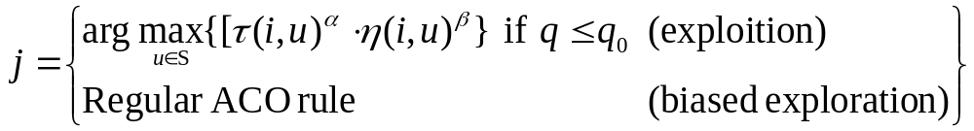
Variant: Ant Colony System (2)
State transition rule from i to j
Greedy rule: pick the best with pre-specified probability q₀
Application of Computational Intelligence in Engineering

Slide 30
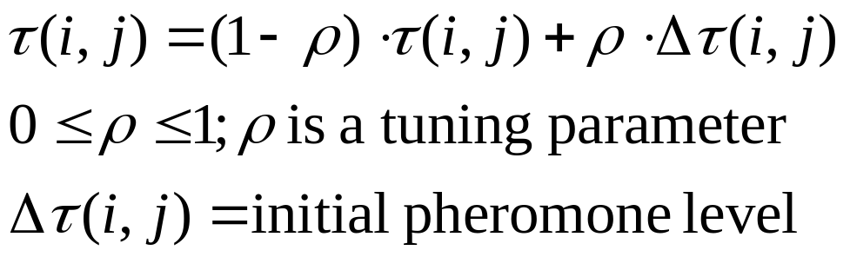
Variant: Ant Colony System (3)
Ants change pheromone level of an edge during their visit
Application of Computational Intelligence in Engineering

Slide 31
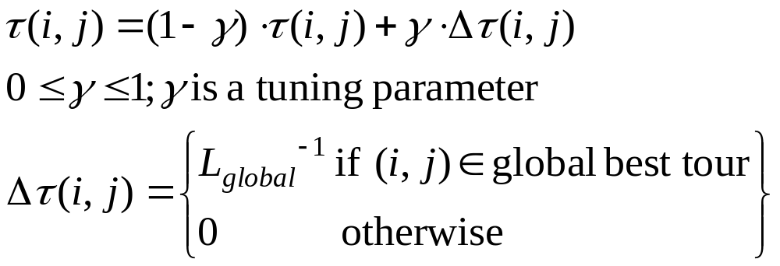
Variant: Ant Colony System (4)
Only globally best ant (i.e., the ant which constructed the shortest tour in all the past iterations) is allowed to deposit pheromone
This is done after all ants complete tours
Application of Computational Intelligence in Engineering

Slide 32
Variant: Population-based ACO (1)
P-ACO maintains a small population P of the k best solutions in past iterations; “elite archive”
P is updated after every iteration; pick the best to enter P
P’s size does not exceed k: remove the oldest solution leaves when a new one enters
The pheromone matrix is derived anew in every iteration from population P
Application of Computational Intelligence in Engineering

Slide 33
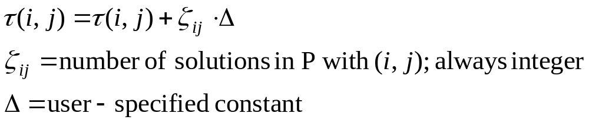
Variant: Population-based ACO (2)
Each pheromone value is increased by
The update of pheromone values can be done as a population update: increasing as (i,j) enters P, decreasing as (i,j) leaves P
No evaporation
Application of Computational Intelligence in Engineering

Slide 34
Advanced Topics (1)
Dynamic optimization problems
  Search space changes during time
    Distances may change; cities are added or removed
    New customers join the request list as vehicles are out
    Telecommunication networks
  Key: Optimization time is highly restricted
    Advantage of using artificial ants
Application of Computational Intelligence in Engineering

Slide 35
Advanced Topics (2)
Continuous optimization problems
  Divide the domain of each variable into a finite set of intervals; then use regular ACO to solve it
  Ants sample next solutions from a continuous probability density function (PDF), not from a discrete list
Application of Computational Intelligence in Engineering

Slide 36
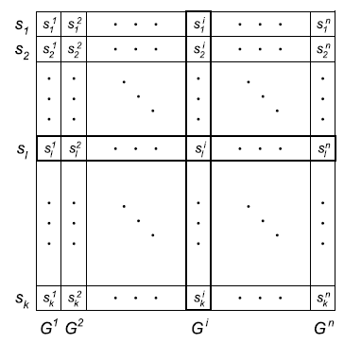
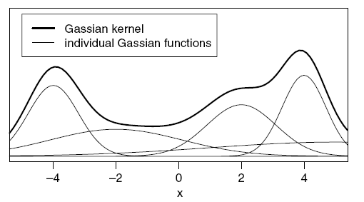

Advanced Topics (2)
solutions
Pheromone Table
variables
weights
Socha, K. and Dorigo, M. (2008). “Ant colony optimization for continuous domains.” European Journal of Operational Research, 185, pp. 1155-1173.
Application of Computational Intelligence in Engineering

Slide 37
Advanced Topics (3)
Parallel implementation
  Multi-colony ACO: Large subpopulations are assigned to single processors and information exchange is relatively rare
  Master-slave ACO: Central processor collects solutions, updates the pheromone matrix, and send back to other processors for future iteration
Application of Computational Intelligence in Engineering

Slide 38
Advanced Topics (4)
Multi-objective optimization problems
  Multiple pheromone matrices
  Ants are attracted to the matrices with various weights
  Using an elite archive to intensify pheromone on good solutions
Application of Computational Intelligence in Engineering

Slide 39
Conclusions
ACO has been used to solve combinatorial optimization problems with success
Similar to other meta-heuristics, ACO is currently evolving
Consider more ill-structured / dynamic / stochastic problems
Application of Computational Intelligence in Engineering

